Slide 1
MULTINEX
Sovereign Memory Infrastructure for AI Agents
Persistent, cryptographic memory for AI agents. VISA identity, mirrored vector storage,
and constitutional governance — all running locally first.
285 passing tests (99% coverage) • 130K LOC (TypeScript + Rust) • 5 production services
5-layer security pipeline • Mirrored vector RAID-1 (384d ↔ 1536d) • VISA protocol (Ed25519 + BASE L2)

Slide 2
AI Adoption Hits a Trust Wall
AI is already in the workflow. Security, compliance, and control are not.
Prompt Injection Is Everywhere
PII and IP Leak by Accident
Legal and Healthcare Are Blocked
ChatGPT, Claude, Gemini, Perplexity, and coding copilots create new attack surfaces at the prompt layer.
Employees paste customer data, secrets, and confidential strategy into consumer AI tools every day.
Regulated teams need client confidentiality, PHI protection, and audit evidence before adoption can scale.
No Unified Control Plane
No Proof of What Happened
AI Spend Stalls Without Trust
Point tools don't follow users across browser tabs, AI apps, or enterprise policy boundaries.
Security teams lack receipts, traceability, and a clean path from user action to policy decision.
The fastest-growing AI budget line is now governance, not just model access.
$10.2M
94%
$2T
Avg US breach cost — IBM 2025
Orgs lack AI security strategy
AI expanding cyber TAM — McKinsey
The first product you buy for AI is security.

Slide 3
Multinex: Sovereign Memory for AI Agents
Agents forget everything between sessions. Multinex gives them persistent, cryptographic memory
with VISA identity — deployed on Cloudflare Workers + Akash Network.
IDENTITY
MEMORY
GOVERNANCE
DEPLOYMENT
VISA Protocol
Mirrored Vector RAID-1
MODUS Constitution
Local-First + Edge
Ed25519 cryptographic agent identity with BASE L2 attestation. Every agent carries a signed passport.
Cross-dimension translation (384d ↔ 1536d) with parity guarantees. Qdrant + FalkorDB dual-writes via WAL.
Constitution-gated behavior enforced at runtime. Principal Architect authority + 5-layer security pipeline.
Ollama on host → Docker runtime → Cloudflare Workers → Akash Network. Hysteresis lock at <12 TPS.
285 passing tests (99% coverage) • 130K LOC • 5 production services

Slide 4
Multinex Product Stack
Aieges Shield
ACQUIRE
Security scanner for AI configs. 365+ patterns, neural classifier, 35+ file types.
Multinex Core (MemQ)
RETAIN
Sovereign memory infrastructure. VISA identity, mirrored vector RAID-1, MODUS constitution, 5-layer security.
VISA Protocol
GOVERN
Cryptographic agent identity on BASE L2. Ed25519 signatures, Airlock namespace isolation, tiered clearance.
Soul Journal
LEARN
Memory distillation + OTel bridge. Converts telemetry into training corpus for sovereign Ollama models.
Edge Deployment
SCALE
Cloudflare Workers + Akash Network. Local Ollama first, Docker runtime fallback, cloud escalation.
Start with Shield (security) → Expand to MemQ (memory + identity) → Own the platform (governance + deployment)

Slide 5
Market Opportunity
AI Security is the fastest-growing segment in cybersecurity.
TOTAL ADDRESSABLE MARKET
SERVICEABLE ADDRESSABLE MARKET
SERVICEABLE OBTAINABLE MARKET
$29B — AI Cybersecurity (2025)
$5.8B — AI Governance + Edge Security
$820M — Browser-First AI Security
Full AI-in-cybersecurity market growing 22–24% CAGR. AI expanding total cyber TAM to $2T per McKinsey.
AI governance ($353M), LLM firewalls, browser/endpoint AI security, and regulated vertical AI compliance tools.
Teams and enterprises buying browser extension + API gateway security for ChatGPT, Copilot, Claude, and Gemini.
Precedence Research, Fortune Business Insights, McKinsey 2025
Grand View Research, IMARC Group 2025
Multinex internal market model
Market Validation
$6.34B
$300M
$400M
AI security funding 2025 (3× YoY)
Lakera → Check Point exit
Robust Intel → Cisco exit

Slide 6
BUSINESS MODEL
AIEGES lands with broad access. The stack compounds the account.
Shield is both a B2C and B2B wedge. Once buyers trust the edge layer, Multinex expands into governed runtime, identity, memory, and autonomous control-plane spend.
ENTERPRISE EXPANSION LADDER
Individual
Teams / Small Firms
$9.99/mo
Personal browser and prompt protection
$550/mo
Shared policy, governance, and auditability
VISA + Airlock
Cryptographic identity, data governance, trust boundaries
+$25K–$75K/yr
Mid-size Regional
Large Enterprise
$2,699/mo
Regional rollouts with centralized controls
$9,499/mo + custom
Network-scale, sovereign controls, dedicated support
Legion Governed Swarm
Compliance-centered shipping lane, audit-ready
+$25K–$100K+/yr
MemQ + M.A.R.S.
Memory, replay, runtime orchestration, autonomous control-plane
→ Infrastructure spend
Blended revenue velocity per enterprise account
$500K to $1M+ ACV

Slide 7
Traction & Launch Readiness
April 1
285
130K
5
Shield public launch
Passing tests (99%)
Lines of production code
Services ready to deploy
LAUNCH TIMELINE
SHIPPED PROOF
Q1 2026 — Development Complete
✅ DONE
285
5
Core infrastructure built: munx-net, VISA protocol, 5-layer security pipeline.
Passing tests
Production services
Q2 2026 — Aieges Shield Launch
99% coverage across all 5 services
Gateway, Edge Slurper, Soul Journal, VISA, Workers
🚀 APR 1
Public release: Chrome extension + Scanner daemon. First revenue wedge.
Q3 2026 — Enterprise Pilots
365+
5-layer
$50K TARGET
Threat patterns
Security pipeline
10 pilot customers at $5K/mo → $50K MRR validation.
Aieges Shield classifier with neural escalation
Sanitizer → Isolation → Constitution → Tier Guard → Output Validator
Q4 2026 — Legion + VISA Expansion
$200K TARGET
Full platform rollout. Identity + orchestration expand ACV.
🚀 LAUNCHING APRIL 1, 2026
Code complete. Tests passing. Launching April 1.
Aieges Shield is production-ready. First revenue wedge.

Slide 8
Competitive Landscape
Two top competitors just got acquired. The market is ours to define.
CAPABILITY
MULTINEX
PROMPT SEC
NOMA
CHECK PT
CREDO AI
Browser Extension
✓
✗
✗
✗
✗
API Gateway
✓
✓
✓
✓
✗
Open Source
✓
✗
✗
✗
✗
Self-Hosted
✓
✗
✗
⚡
✗
Memory Layer
✓
✗
✗
✗
✗
Agent Runtime
✓
✗
⚡
⚡
✗
Governance/Audit
✓
⚡
✓
⚡
✓
Entry Price
$9.99
$500+
Custom
Custom
Custom
Only platform with browser extension + API gateway + memory layer + open source.
Two category leaders validated the space at $300M+ exits, then went inside incumbents. We remain the independent, startup-speed alternative.

Slide 9
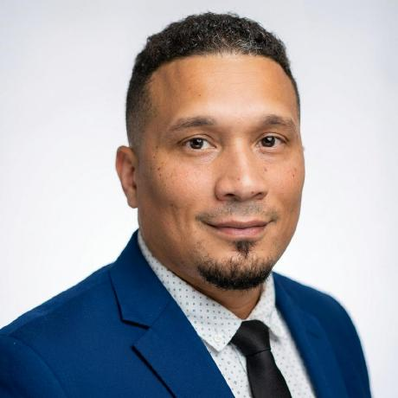
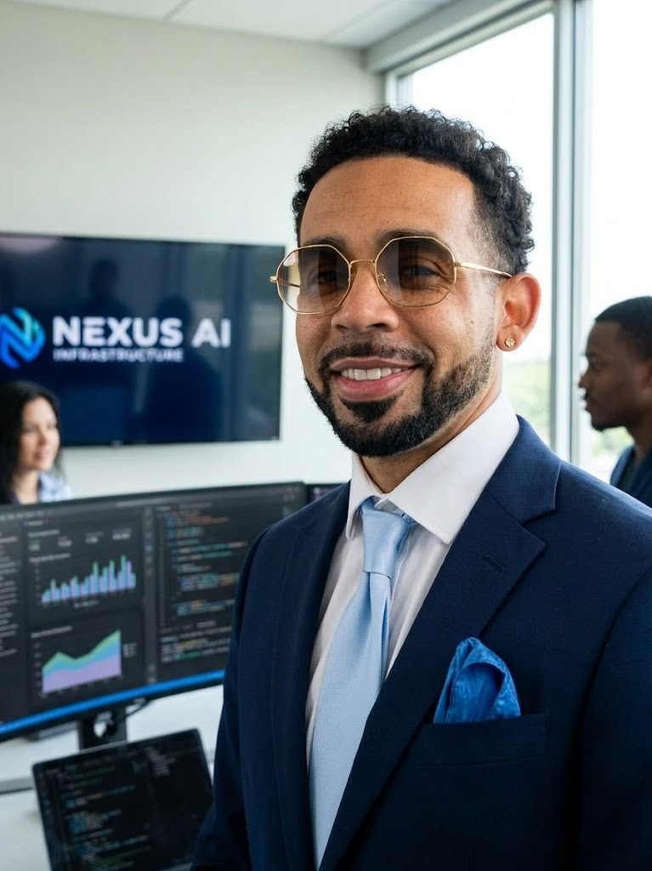

Founding Team
Christopher Rijos
Jamaal Barnett
Shannon O'Brien
Principal Architect & Founder
Core Team (Frontend & Community)
Core Team (Legal & Compliance)
• Former founder/president Warp Industries Inc. (AI Cloud Orchestration)
• Ex-Principal SWE Ahold Delhaize, Founding Engineer Kodex (a16z-backed)
• AI Redteaming Engineer Mercor, Web3 Farcaster Contributor
• Decade of expertise in React, Angular, TypeScript, Ionic ecosystems
• Full SDLC mastery from architecture to deployment
• Developer relations + community growth
• Extensive experience in highly regulated industries
• Technology + AI law intersection, licensing, compliance standards
• SOC2, HIPAA, data privacy, operational governance
multinex.ai/team — Full team registry

Slide 10
The Ask
Building sovereign AI infrastructure & security for autonomous AI.
$2M
PRE-SEED ROUND
$10M Post-Money Valuation • SAFE (Y Combinator Terms) • Q2 2026 Close
📊 USE OF FUNDS (24 MONTHS)
15%
35%
Product & Engineering — $300K
Market Exposure & GTM — $700K
Infrastructure, security audits, platform hardening
Content, conferences (RSA, BlackHat), DevRel, PR
25%
25%
Compliance Standards — $500K
Strategic Partnerships — $500K
HIPAA, SOC2 Type II, EU AI Act, legal
AIUC research, AAPAA petition, enterprise pilots
🎯 24-MONTH MILESTONES
Q2 2026
Q4 2026
Q2 2027
Q4 2027
$50K MRR
$200K MRR
$500K MRR
$2M MRR
5 enterprise pilots
20 customers, HIPAA
Series A, SOC2
Path to profitability

